Slide 1
Arduino Week 3 – Outputs & FIRMATA
CCLab 2016

Slide 2
Go to
sparkfun.com/sikcode
copy the “SIK Guide Code”folder into Arduino’s folder named “examples”
Notes:
While there are many helpful examples in this folder, we’ll just be using Example Files 03 and 12

Slide 3
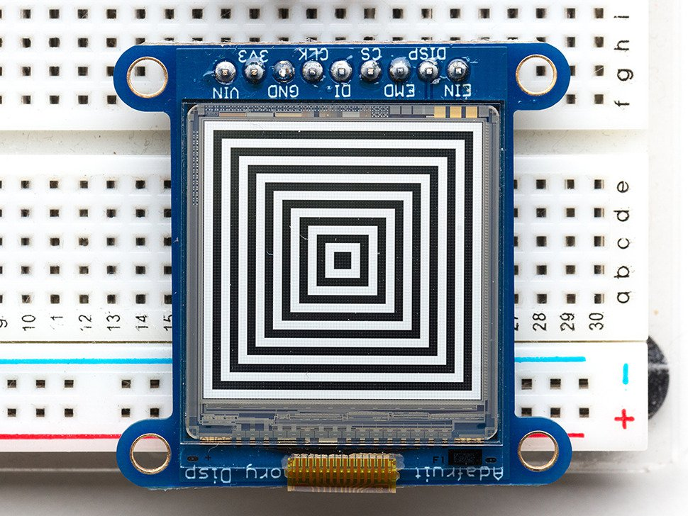

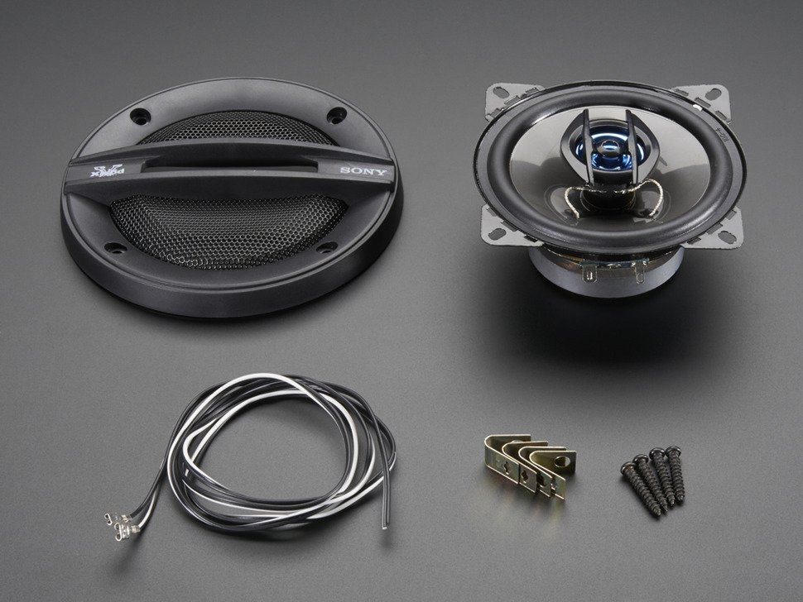
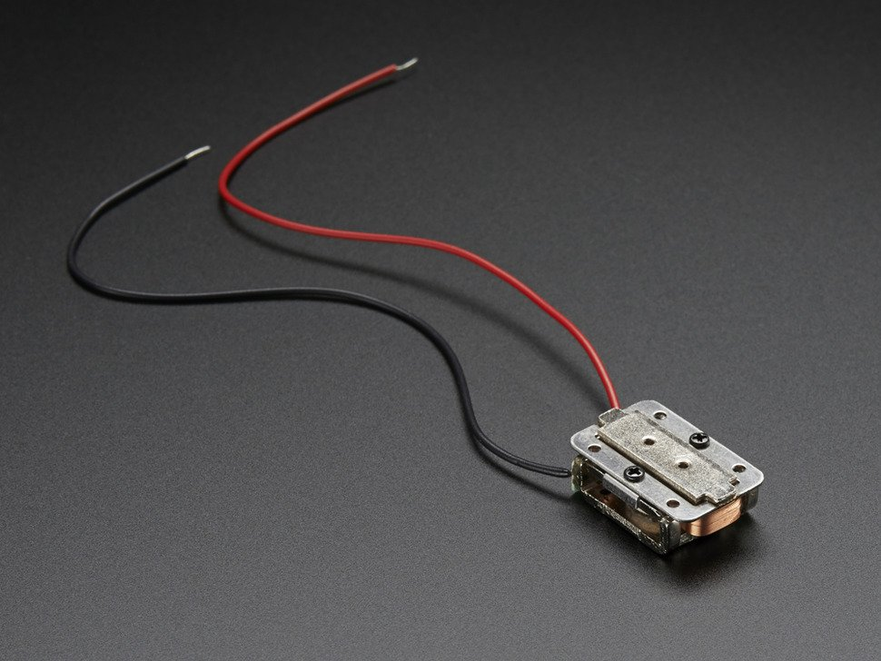
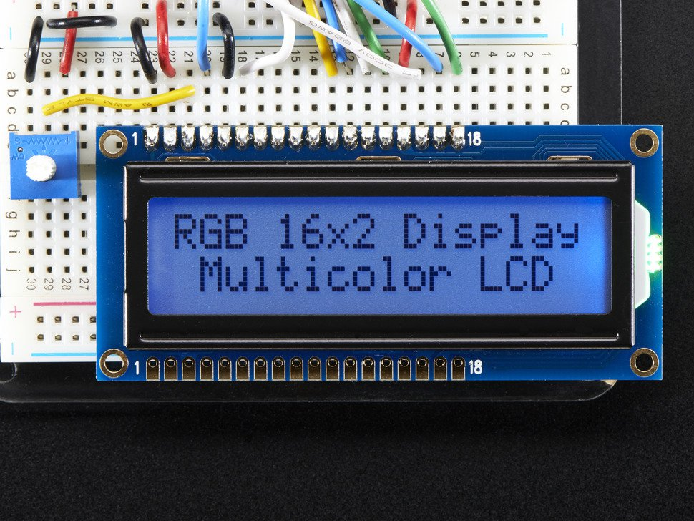
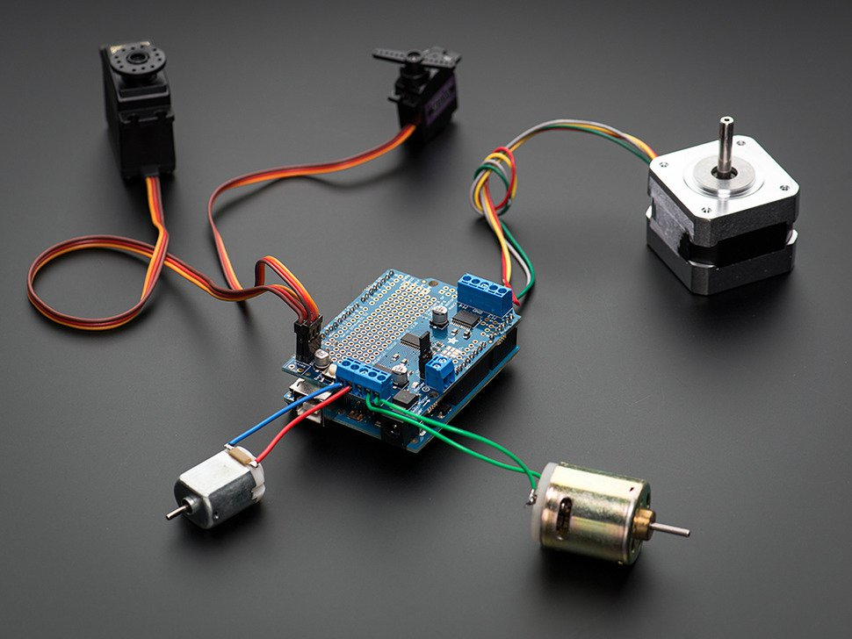
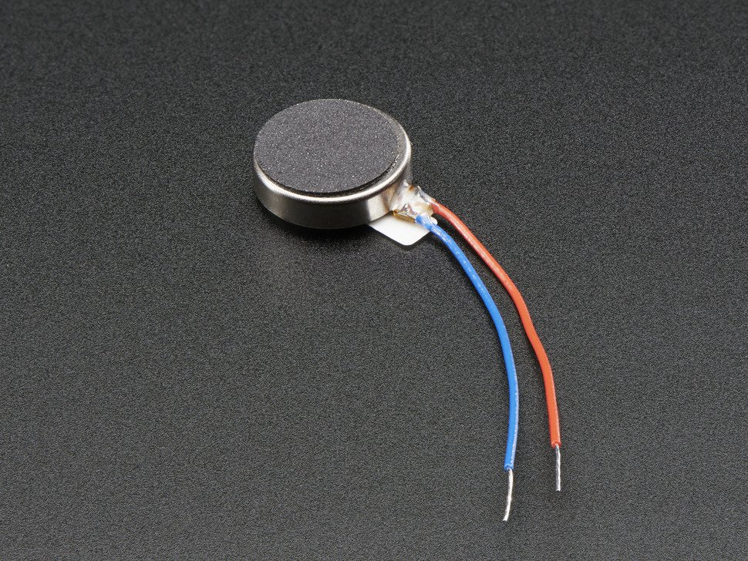

There are many other outputs besides LEDs for use with Arduino ☺
eInk Display
EL Wire
Speakers
Bone Conduction
Transducer
LCD Display
Motors
Vibrating Motor Disc
Receipt Printer

Slide 4

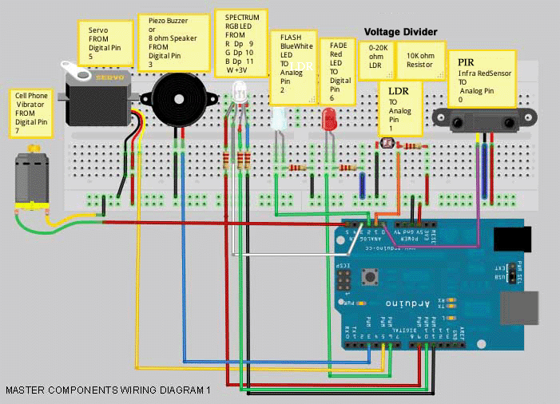
Creating Outputs
Notes:
We won’t actually be connecting all of these components to our Uno’s today

Slide 5
MULTIPLE LEDs

Slide 6
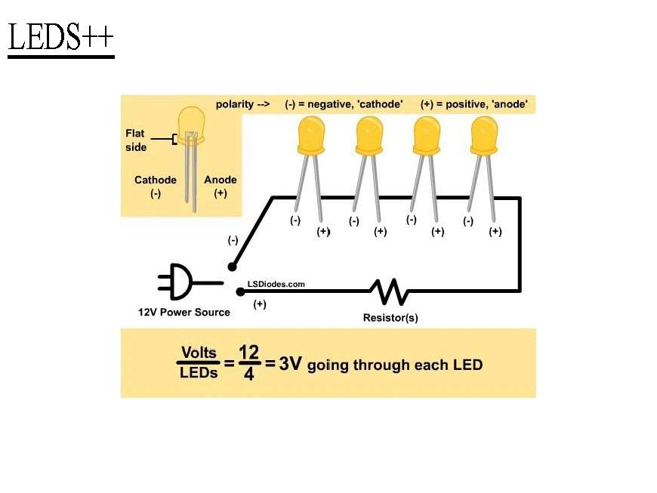
Series Circuit
Two components are in series if they share a common node and if the same current flows through them.

Slide 7
Parallel Circuit
If components share two common nodes, they are in parallel.

Slide 8
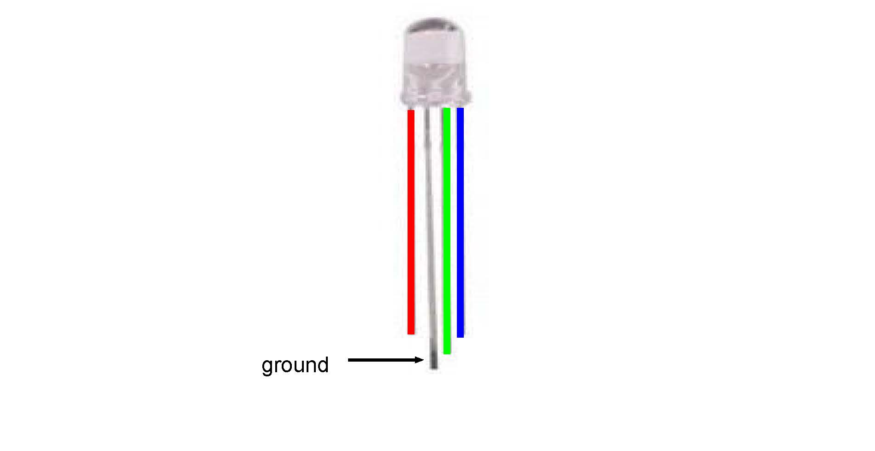
RGB LED
Notes:
An RGB LED is actually three LEDs (red, green, and blue) in
one package. When you run them at different brightnesses,
the red, green and blue mix to form new colors.
Starting at the flattened edge of the flange on the LED,
the pins are ordered RED, COMMON, GREEN, BLUE.

Slide 9
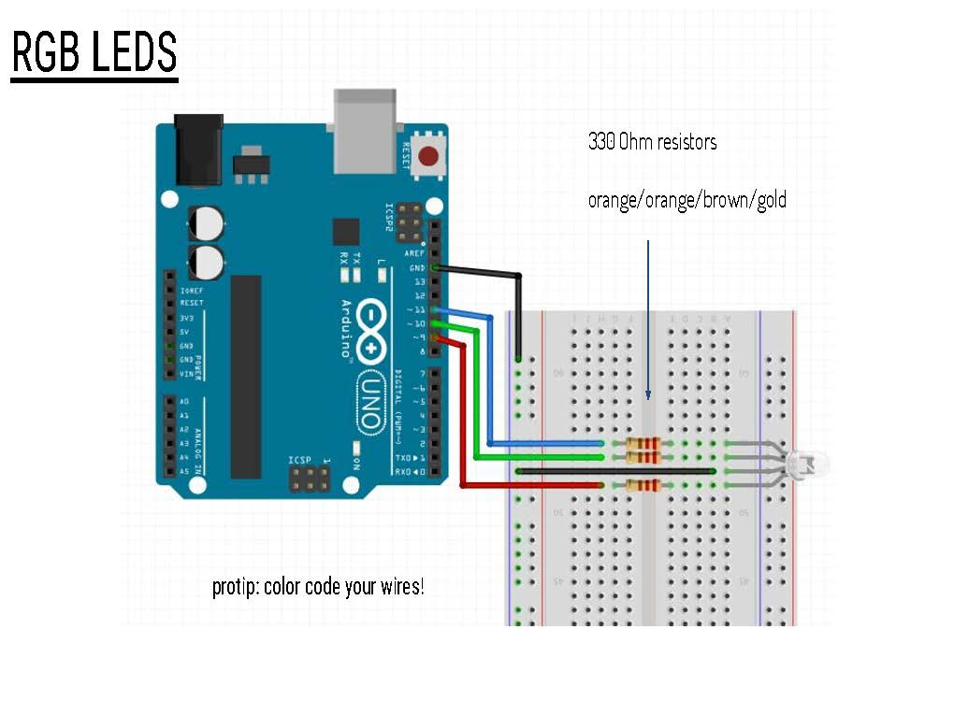
file->example->SIK Guide Code->Circuit_03
Notes:
Connect RED to a 330 Ohm resistor. Connect the other end
of the resistor to Arduino digital pin 9.
Connect COMMON pin to GND.
Connect GREEN to a 330 Ohm resistor. Connect the other end
of the resistor to Arduino digital pin 10.
Connect BLUE to a 330 Ohm resistor. Connect the other end
of the resistor to Arduino digital pin 11.

Slide 10
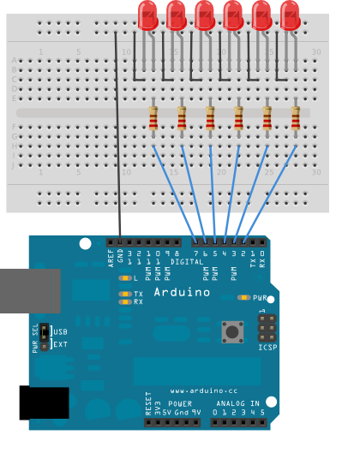
Multiple LEDs
Arduino>Examples>Control>Arrays
Arduino>Examples>Control>ForLoopIteration

Slide 11
Motors

Slide 12
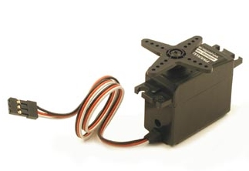
Servo Motor
Can be precisely controlled
On standard servos, the shaft can be positioned at various angles between 0 and 180 degrees
Continuous rotation servos allow the rotation to be set to various speeds
Notes:
Servos have integrated gears and a shaft that can be precisely controlled. Standard servos allow the shaft to be positioned at various angles, usually between 0 and 180 degrees. Continuous rotation servos allow the rotation of the shaft to be set to various speeds.

Slide 13
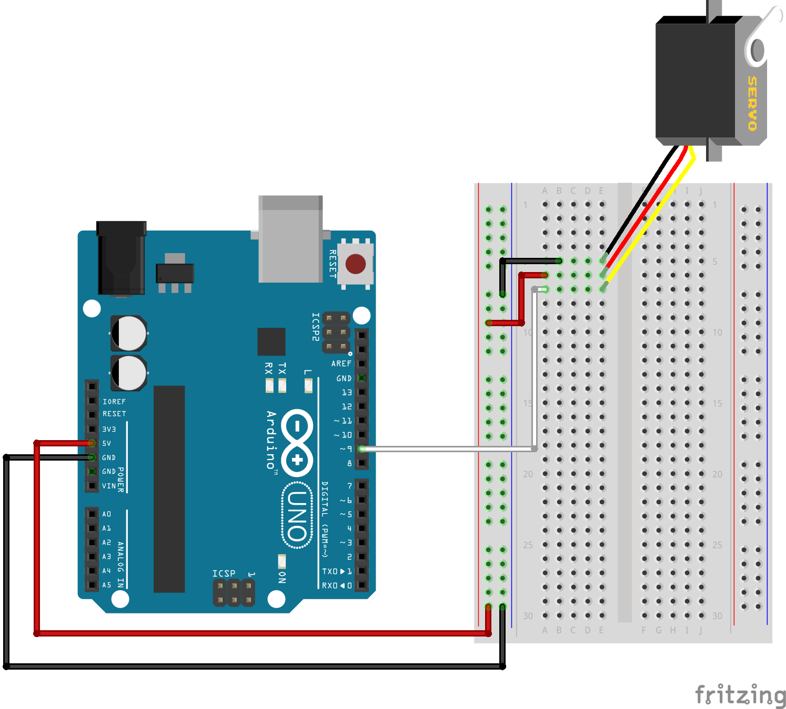
Servo Sweep
Arduino > Examples > Servo > Sweep
Sweep the shaft of a servo motor back and forth.
Notes:
Sweep a servo back and forth through its full range of motion.
A "servo", short for servomotor, is a motor that includes
feedback circuitry that allows it to be commanded to move to
specific positions. This one is very small, but larger servos
are used extensively in robotics to control mechanical arms,
hands, etc. You could use it to make a (tiny) robot arm,
aircraft control surface, or anywhere something needs to be
moved to specific positions.

Slide 14
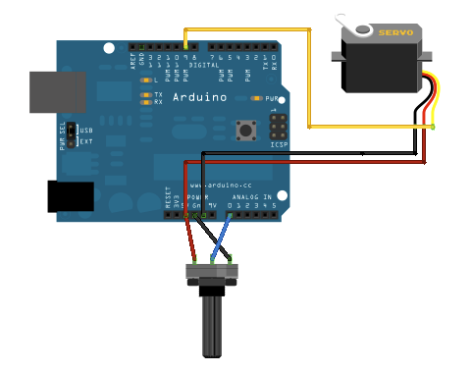
Servo Knob
Arduino > Examples > Servo >Knob
Control the position of a servo with a potentiometer.

Slide 15
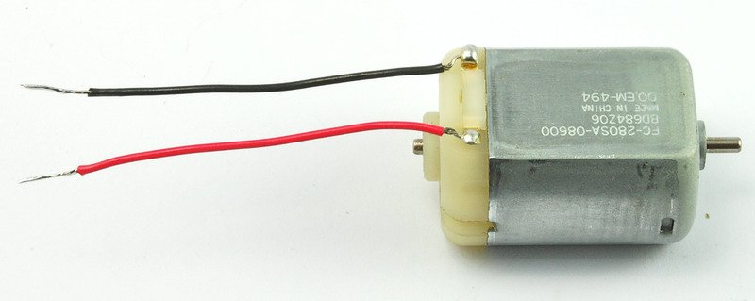
DC Motor
The most common type of motor
Normally they have just two leads, one positive and one negative

Slide 16
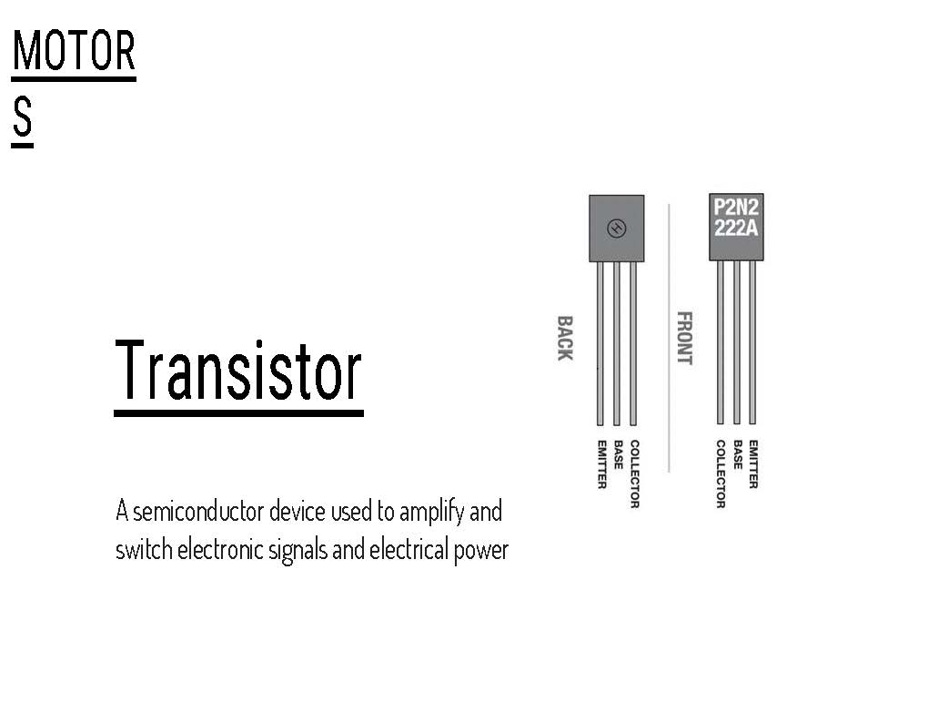
A transistor is a solid-state switch. When we give it a small
amount of current, it can switch a much larger current.
Notes:
Before we start, let’s talk about some things you’ll need to add to make the motor work…
Because the motor needs more current than an Arduino pin can
provide, we'll use a transistor to do the heavy lifting.
A transistor is a solid-state switch. When we give it a small
amount of current, it can switch a much larger current.
You can turn a transistor on and off using the digitalWrite()
function, but you can also use the analogWrite() function to
vary the speed of the motor. The analogWrite() function pulses
a pin, varying the width of the pulse from 0% to 100%. We call
this technique "PWM", for "Pulse-Width Modulation".
One thing to keep in mind is that when you lower the speed of
a motor using PWM, you're also reducing the torque (strength)
of the motor. For PWM values below 50 or so, the motor won't have
enough torque to start spinning. It will start spinning when you
raise the speed a bit.

Slide 17
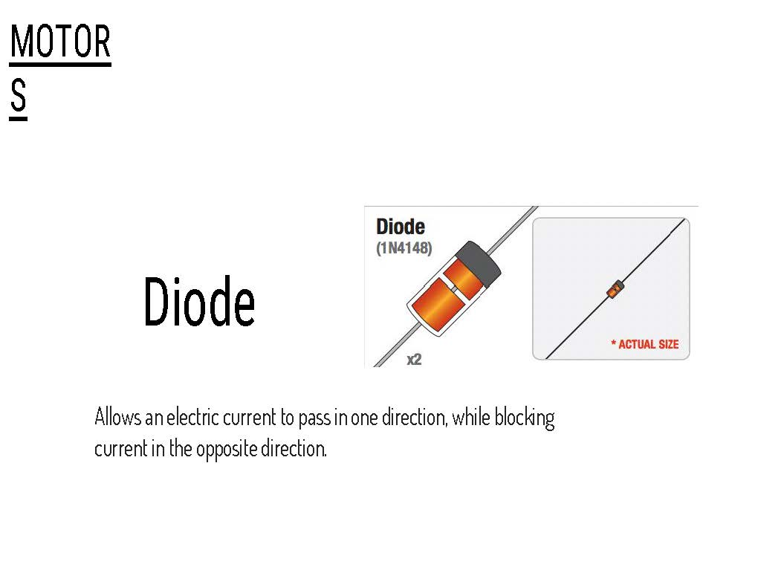
Notes:
Flyback diode:
When the motor is spinning and suddenly turned off, the
magnetic field inside it collapses, generating a voltage spike.
This can damage the transistor. To prevent this, we use a
"flyback diode", which diverts the voltage spike "around" the
transistor.
Connect the side of the diode with the band (cathode) to 5V
Connect the other side of the diode (anode) to the black wire
on the motor.

Slide 18
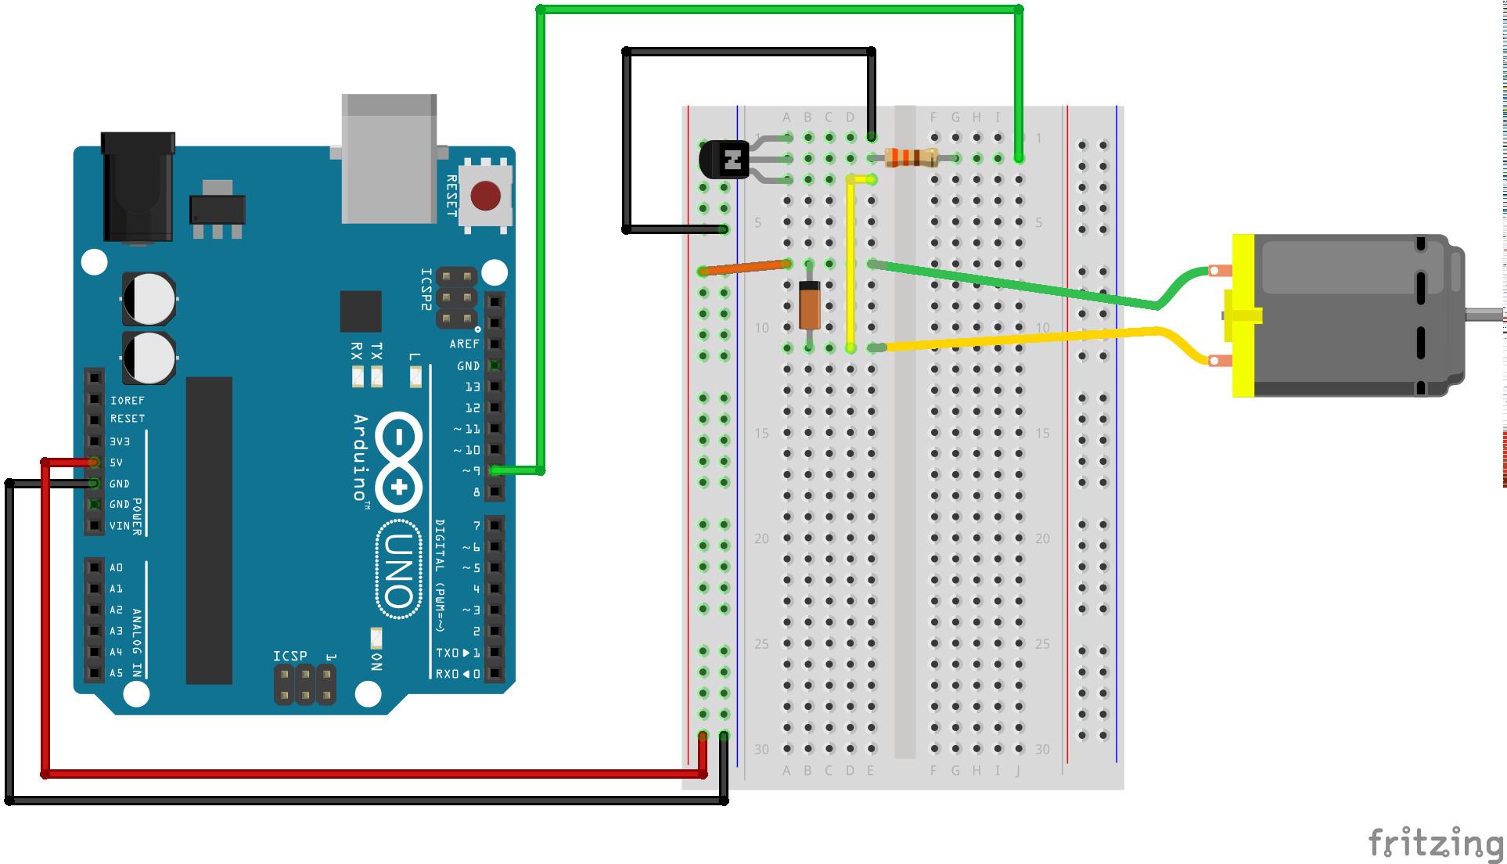
DC Motor
Arduino>file>example>SIK Guide Code>Circuit_12
Notes:
The Arduino pins are strong enough to light small LEDs (up to
40 milliAmps), but they're not strong enough to run motors and
other power-hungry parts. (This motor needs 50-100mA).
The transistors in your kit (2N2222) can switch up to 200mA.

Slide 19
Communication Protocols Quick Question! What are protocols? Why are they important? Give an example.

Slide 20

FIRMATA

Slide 21
What is Firmata?
Firmata is a generic protocol for communicating with microcontrollers from software on a host computer.

Slide 22
Why use Firmata?
ATmega328P microcontroller running at 16MHz, the 32Kb of memory space on an Arduino is not enough for larger projects. It would be great if we can harness the power of our PC to do the complex processing while the Arduino can be the platform for the sensors and motor controls.

Slide 23
Processing = Master Arduino = Slave

Slide 24
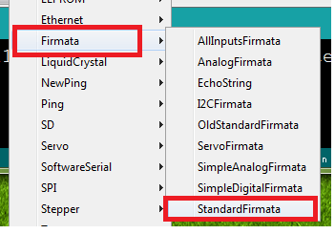
Load Firmata on Arduino

Slide 25
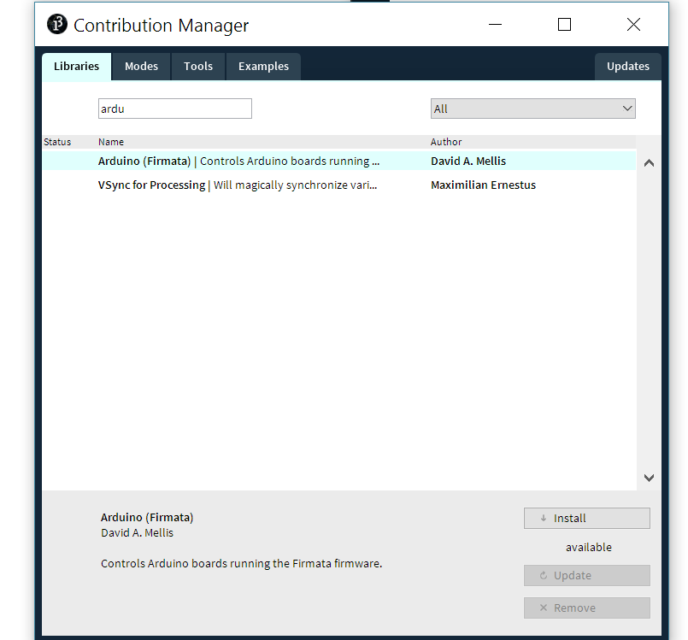
Install Firmata library in Processing

Slide 26
Processing code
Now use "Open..." to open the example in the Arduino library (in Processing). Processing Folder -> libraries -> arduino -> examples -> arduino_input -> arduino_input.pde

Slide 27
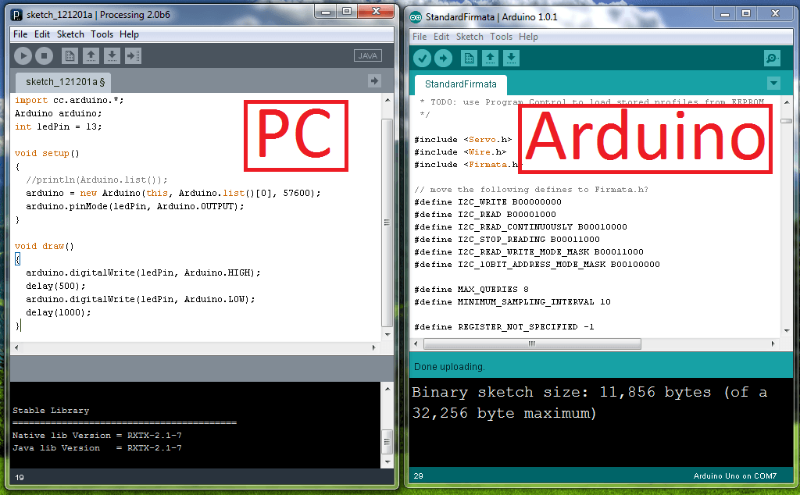
this is an old screenshot ( disregard the code)
Now that we have both systems connected, there is no need to compile and upload to the Arduino anymore.

Slide 28
Processing code
The sketch will :-
- draw a filled box for each digital pin that's HIGH (5 volts).
- draw a circle whose size corresponds to the value of an analog input.

Slide 29
Pro Tip
Read up on OSC libraries
You can use OSC library in processing to ‘talk’ to other applications on same network over WiFi. Now you can clearly make much larger interconnected systems!
Processing Lib: http://www.sojamo.de/libraries/oscP5/
OpenFrameworks Lib: https://github.com/palida/ofxOsc
Full Spec: http://opensoundcontrol.org/spec-1_0

Slide 30
Homework
Use Firmata Serial library to control hardware connected to your Arduino from an interactive processing sketch.
You know the drill:
- Submit code on github
- Video link in readme.md
Bonus Points:
Plot a visualization of a sensor data in a processing sketch
Insane bonus: Implement everything without firmata:
Helper code from Large Systems, MFADT Spring 2015 (Ramsey Nasser)
https://gist.github.com/nasser/476fb7ee2e744cdc88b0

Slide 31

Oh yes, midterms… It’s time to shine!

